Slide 1
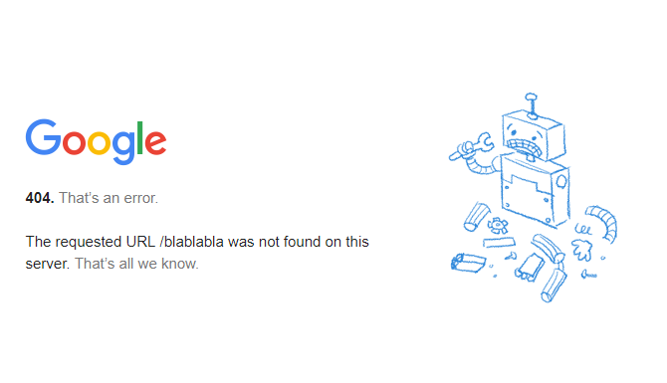
USING THE WEB INFRASTRUCTURE FOR REAL TIME RECOVERY OF MISSING WEB PAGES
August 2011
By
Martin Klein
CS 791/891 – Archiving Seminar
Presented by: Plinio Vargas
Computer Science Department
November 29, 2017

Slide 2

Problem
Are they really gone or relocated?
Do any search engines have a copy?
Has the page been archived?
Is the employment of IR techniques needed to rediscover their content?

Slide 3
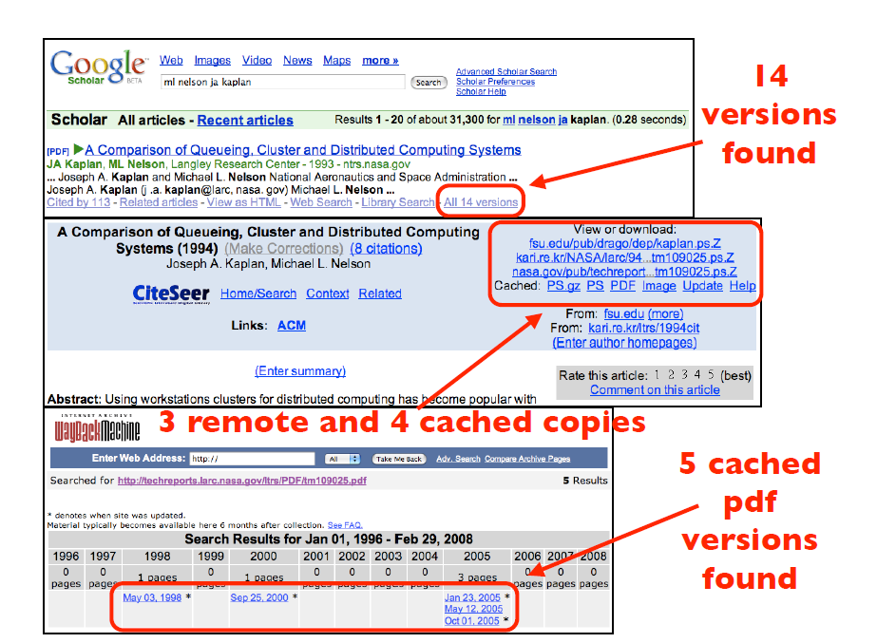
Web pages do not disappear; they need to be rediscovered
Same URI maps to the same or very similar
content at a later time
Same URI maps to different content at a
later time
Different URI maps to the same or very similar
content at the same or at a later time
The content cannot be found at any URI

Slide 4
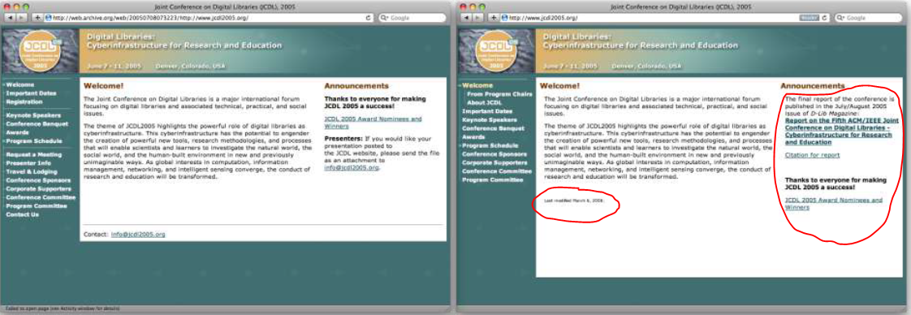
Example of Same URI Mapping to Very Similar Content at Later Time
http://www.jcdl2005.org/
July 2005
http://www.jcdl2005.org/
2011

Slide 5
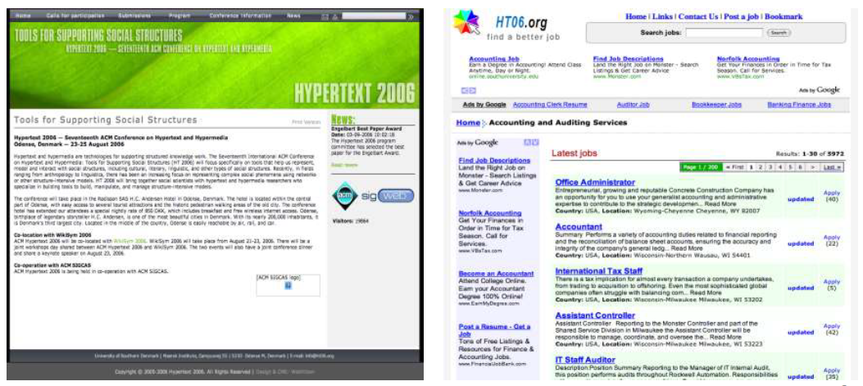
Example of Same URI Mapping to Different Content at Later Time
http://www.ht06.org/
August 2006
http://www.ht06.org/
2011

Slide 6
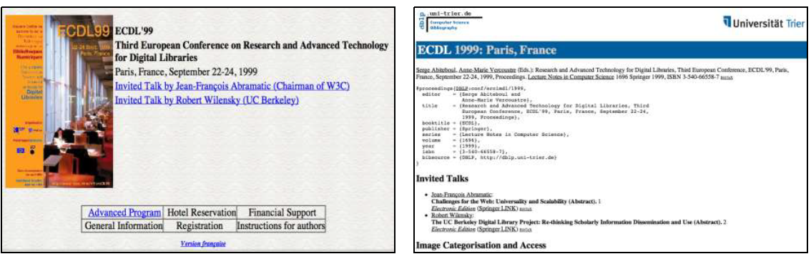
Example of Different URI Mapping to Similar Content at Later Time
http://www.informatik.uni-trier.de/~ley/
db/conf/ercimdl/ercimdl99.html
2011
http://www-rocq.inria.fr/EuroDL99/
October1999

Slide 7
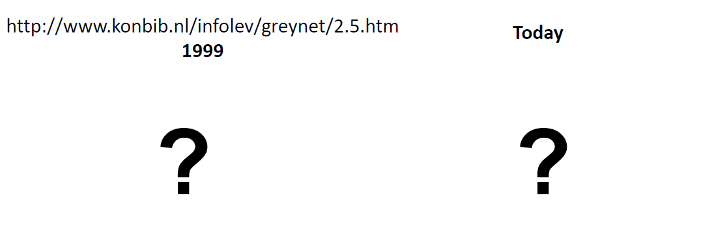
Example of Content Cannot Be Found

Slide 8
Contribution
Synchronicity: Mozilla Firefox add-on rediscovering missing pages in real time
Book of the Dead: a corpus of real missing web pages

Slide 9
Similarity/Difference of Synchronicity with Other Research
Opal (Harrison and Nelson)¹
Feeds lexical signatures into WI to find missing pages
Server side (difference)
¹Harrison, T.L., Nelson, M.L.: Just-in-Time Recovery of Missing Web Pages. In: Proceedings of HYPERTEXT '06, pp. 145-156 (2006)

Slide 10
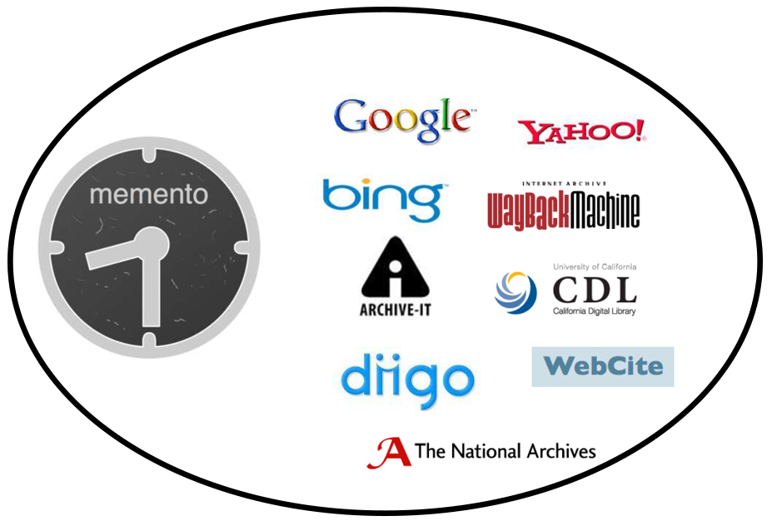
Tools
Web Infrastructure
Lexical Signature
Titles
Tags
Link Neighborhood
Lexical Signatures
Content & link structure
Rediscover real time

Slide 11
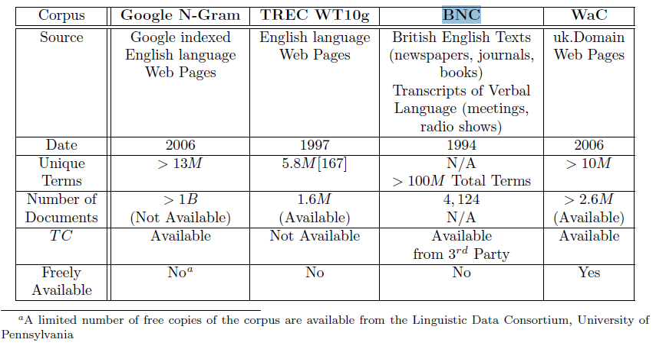
Text Corpora Availability

Slide 12
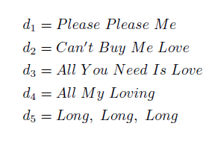
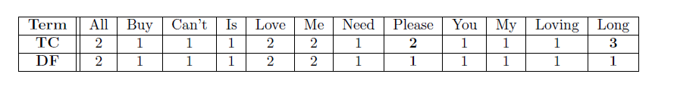
Calculation of TC and DF values

Slide 13
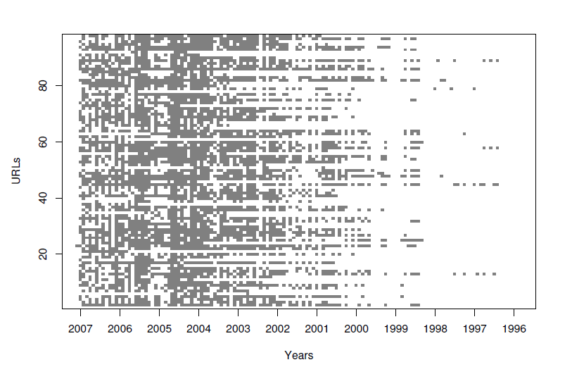
Local Universe
Randomly sample 300 URIs from dmoz.org
Only .com, .org, .net, .edu domains were selected
Only English language websites
Webpage had to contain more than 50 words
Final set: 78 .com, 13 .org, 5 .net, and 2 .edu URIs
Total of 98 URIs
Mementos from the IA from 1996 to 2007

Slide 14
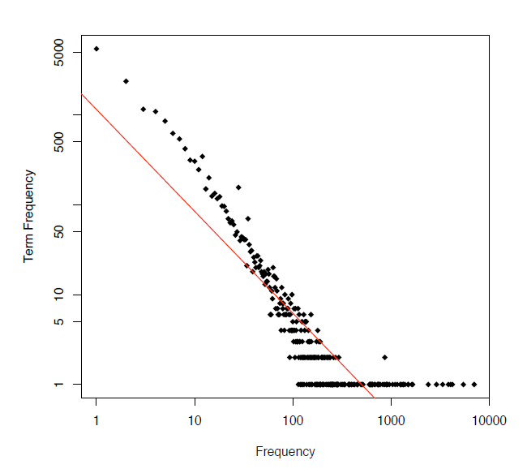
Term Extraction for Locally Computed Data
All terms for each Memento were extracted
Total number of terms: 254,384
Number of unique terms: 16,791
A database of terms was also separated by year
LC dataset follows Zipf distribution of English language terms

Slide 15
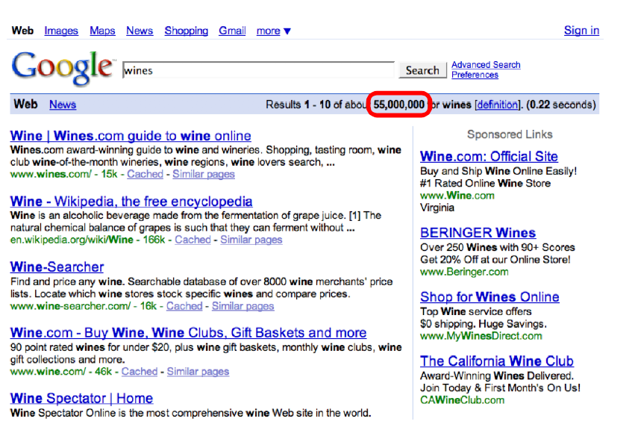
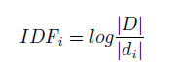
Screen Scraping IDF Calculation
D_{i} = number of document in D that contains term i
D = number of documents in the corpus for 2008
Screen Scraping the Google Web Interface

Slide 16
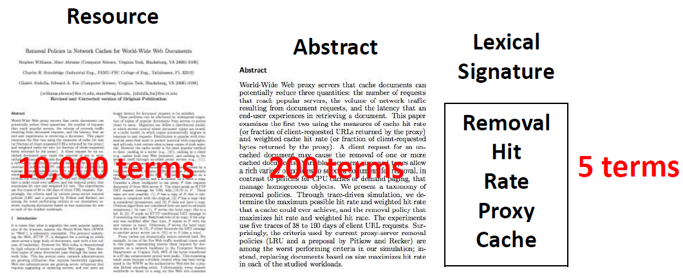
Lexical Signatures (LS)
“Small set of terms derived from a document that captures the ‘aboutness’ of that document.”

Slide 17
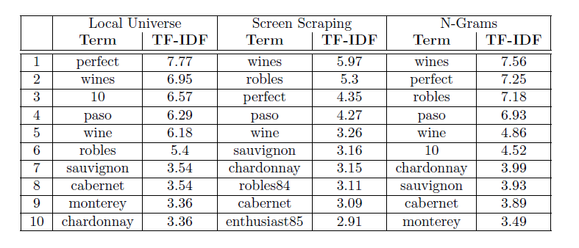
Lexical Signature Comparison
Top TF-IDF values generated from http://pefect10wines.com
Note: TF-IDF values for any given term is its TF * IDF

Slide 18
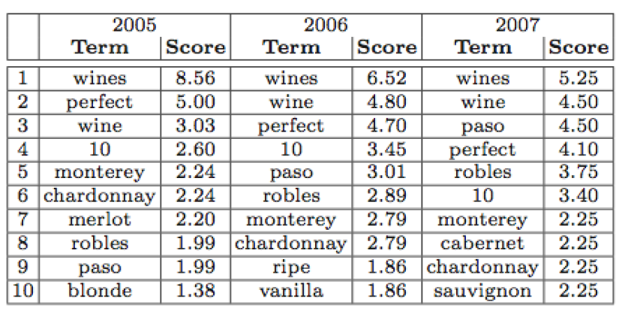
Lexical Signature Over Time
Top TF-IDF values generated from http://pefect10wines.com using Local Universe
Note: TF-IDF values for any given term is its TF * IDF

Slide 19
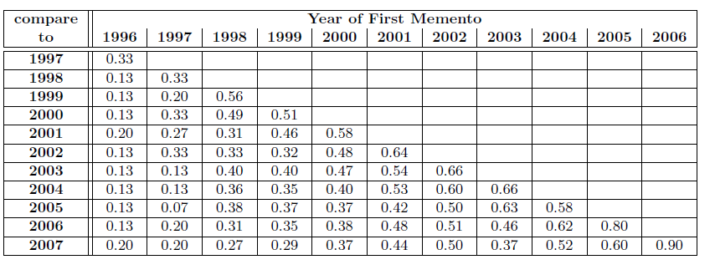
Rooted Evolution of Lexical Signature Over Time
Results:
Little overlap between the early years and more recent one
Highest overlap in the first 1-2 years after creation of the LS
Once terms are gone do not return

Slide 20
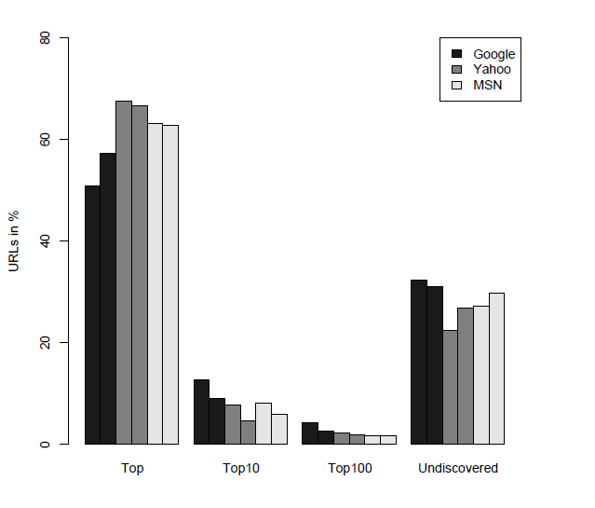
Best Performance Retrieval are 5-Term and 7-Term LS

Slide 21
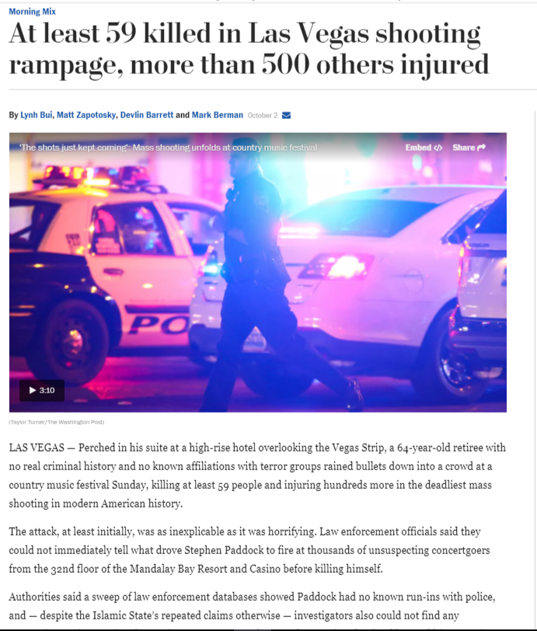
Title as a Method to Obtain “Contextual Aboutness” of a Page
Lexical Signature is expensive
Assumption most web pages contain titles
Titles are descriptive of the page
Assumption titles do not change frequently
over time
Can this method perform equally or better than lexical signatures?

Slide 22
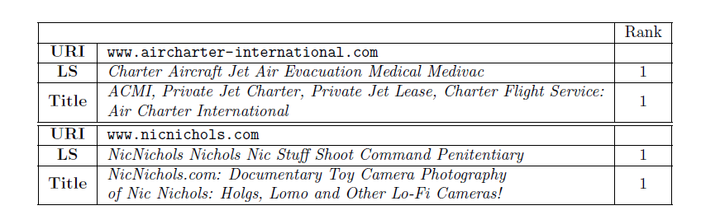
Measuring Title Extraction Effectiveness
Query against Google returns all cases the target URI top ranked.

Slide 23
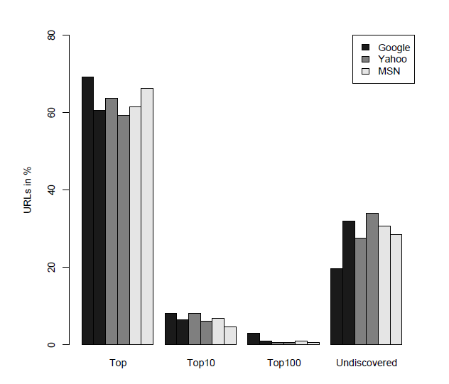
Measuring Title Extraction Results
Non-Quoted and Quoted Title Retrieval Performance

Slide 24
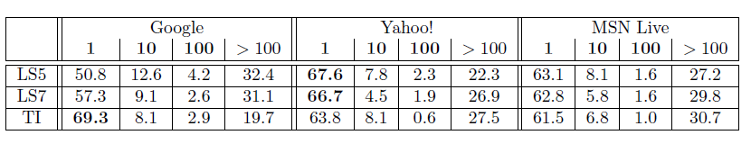
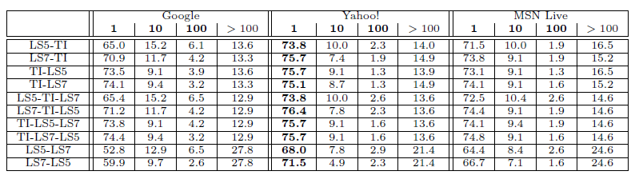
Measuring LS and Title Extraction Methods
URIs retrieved using single methods
URIs retrieved using two or more methods

Slide 25
Factors Considered in Title Usefulness
Length
Collision
Quality of web pages titles
Evolution over time

Slide 26
Why Use Tags?
LS and titles fail if a Memento of missing page cannot be found
Tags may be descriptive of the page content
Beneficial to retrieve other potential relevant documents
Added value for rediscovering missing web pages in combination with previous methods

Slide 27
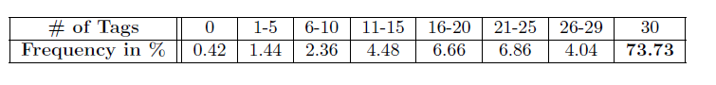
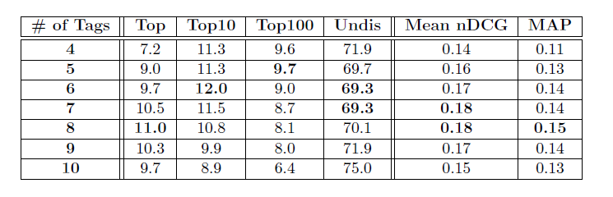
Measuring Tags in Documents
Delicious.com Query of 5000 URIs Using Delicious Random Tool
Relative Retrieval Numbers for Tag Based Query Length, nDCG and MAP

Slide 28
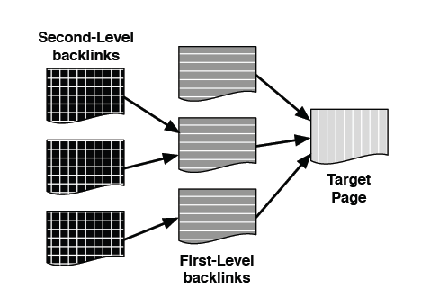
Link Neighborhood Lexical Signatures
LS and titles fail if a Memento of missing page cannot be found
Pages no longer available when the user links to it
For each first-level backlink, second level was obtained
Total pages retrieved: 335,334. Of that, 28,325 were first-level, and 306,700 were second-level backlink pages

Slide 29
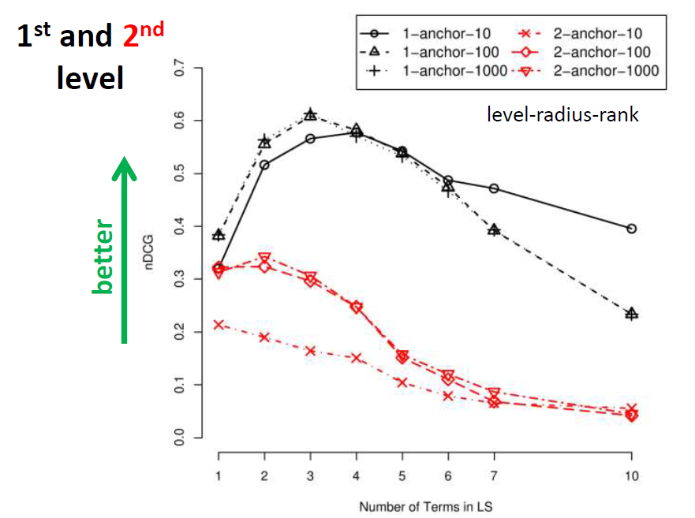
Link Neighborhood Lexical Signatures Results

Slide 30
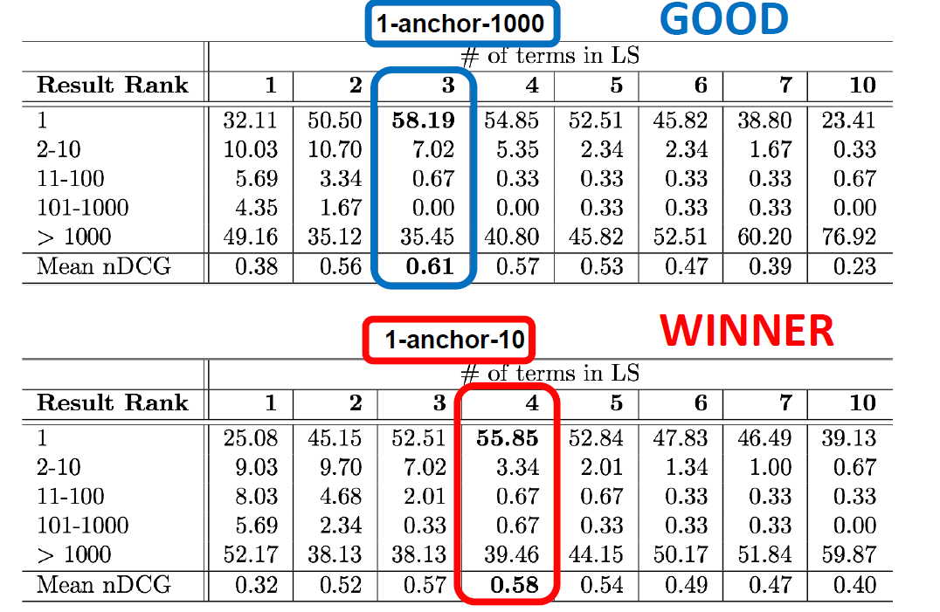
Link Neighborhood Lexical Signatures by the Numbers

Slide 31

Synchronicity
Firefox add-on
Triggers on 404 error
Rediscover page via:
Memento
Title
Lexical Signature
Tags
Link Neighborhood Lexical Signature

